Slide 1
The Introduction of Nursing Care Demand and Health Care Delivery System in Japan and China
Sep 25th. 2024
Meijie Sang
Visting Researcher,
Department of International Research Center for Medical Education
Graduate School of Medicine, The University of Tokyo

Slide 2
Topics
  1. Nursing Care Demand
  2. Health Care Delivery System
    Medical Care Delivery System
    Medical Insurance System
    Long-term Care Delivery System
    Long-term Care Insurance System

Slide 3
Topics
  1. Nursing Care Demand
  2. Health Care Delivery System
    Medical Care Delivery System
    Medical Insurance System
    Long-term Care Delivery System
    Long-term Care Insurance System

Slide 4
Nursing Care Demand (in Japan)
With the aging society is steadily progressing，demand for nursing care is expected to peak in 2035.
Against this background, the need for nursing professionals is expected to increase.
As of the end of 2020, the number of nursing staff, such as nurses and assistant nurses, is about 1.28 million, but by 2025 when the baby boomers reach the late-stage elderly, the number will increase to between about 1.75 million and about 1.82 million.

Slide 5
Nursing Care Demand (in Japan)
To be specific，
Growing Needs for Geriatric Nursing;
The future demand for nursing in community health centers and health care offices of private companies is expected to increase;
Human resources with advanced specialized knowledge are required, such as Emergency Nursing,Certified nurses......
Reference: Basic data on supply and demand of nursing staff - Ministry of Health, Labor and Welfare
Notes:
Due to national medical policy, the number of hospital beds is being reduced and the length of hospitalization is being shortened, increasing the importance of recuperating at home after discharge. As a service to respond to such situations, there is a growing need for home-visit nursing, in which nurses visit patients' homes to provide nursing care. In home-visit nursing, based on the home-visit nursing instructions prepared by the attending physician, health status checks, recuperation guidance, medical treatment, and physical nursing are performed. Users range in age from infants to the elderly. There are a wide variety of medical departments, including internal medicine, psychiatry, neurology, and orthopedics. Most of the places where nurses engaged in home-visit nursing work are home-visit nursing stations. The number of home-visit nursing stations has increased rapidly since the fiscal 2012 revisions to medical and long-term care fees, and will reach approximately 13,000 in 2021. As of 2019, the number of nurses working at home-visit nursing stations has increased to approximately 55,000. It is estimated that the government will need 120,000 home-visit nurses by 2025 in order to promote the construction of a "comprehensive community care system" that allows people to receive medical care and nursing care in familiar areas.
As the number of elderly people increases, the demand for long-term care insurance facilities is increasing, and the role of nurses working there is becoming more and more important. According to the 2020 survey of long-term care service facilities, long-term care insurance facilities include 8,306 long-term care welfare facilities, 4,304 long-term health care facilities, 556 long-term care medical facilities (to be abolished in 2023), and 536 long-term care medical facilities. there is. A caregiver's main job is to support the overall life of residents in nursing homes, but nurses perform health management and medical care, such as checking the vitals of residents. In the case of nursing homes where doctors are not always present, nurses provide first aid in the event of a sudden change in a resident's condition, and take on the role of handing over the care to ambulance crews and doctors. Recently, it has also played a role in infection control to prevent the occurrence of new coronavirus infection clusters (groups of infected people) at nursing homes. As of 2019, there were 27,000 nurses working at health care facilities for the elderly, 26,000 at welfare facilities for the elderly, and 19,500 at social welfare facilities, and demand is increasing.
Human resources with advanced specialized knowledge are required
On the other hand, there is a demand for nurses who can practice high-level nursing in the medical field, where sophistication and specialization are progressing. Certified nurses are certified by the Japanese Nursing Association for each field of nursing. It is a qualification that can be obtained by having more than 5 years of practical experience as a nurse, completing more than 600 hours of certified nurse education set by the Japanese Nursing Association, and passing the certified nurse certification examination. As of July 2019, approximately 20,000 certified nurses are active nationwide. There are 21 fields identified as certified nursing fields, including "Emergency Nursing".
Certified nurses make judgments based on specialized knowledge and practice for patients and families who need difficult treatment and nursing. In addition, they provide guidance to other nurses on specialized knowledge and nursing techniques, encourage them to perform high-level nursing, provide consultation on problems and questions they face in the nursing field, and support them in deriving improvement measures. or In addition to hospitals, certified nurses work at home-visit nursing stations, clinics and clinics, and nursing care insurance facilities.
In 2015, the Japanese government established a system called "Training for Specified Acts" that allows nurses with expertise to assist in difficult medical care. We would like to renew the certification system in the form of a "specific certified nurse" that incorporates It is expected that there will be an increase in the number of nurses with high practical skills who will be able to provide appropriate treatment without waiting for the arrival of doctors, even when hospitalized or at home.
In addition, there are qualifications in more specialized fields, such as specialized nurses who are specialists in not only specialized fields but the entire nursing field, and clinical nurses who can perform a wider range of medical procedures than specified nurses.
Nursing qualification is not the goal, it is just the beginning. The job of a nurse who takes care of people's lives is physically and mentally hard, but it can be said that it is a profession that has many opportunities to feel more rewarding than others.

Slide 6
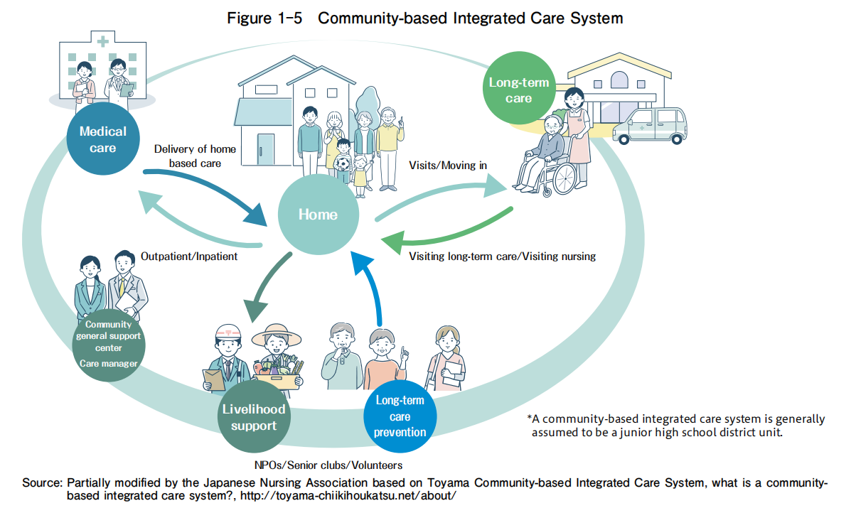
Social Security System Reforms Toward 2025 (in Japan)
The community-based comprehensive care system is a system that provides housing, medical care, nursing care, prevention, and lifestyle support in an integrated manner so that people can continue to live the way they want in the areas they are familiar with, even if they become severely dependent on nursing care.

Slide 7
Community Comprehensive Support Centers
Municipalities will develop and implement nursing care insurance business plans every three years with the aim of achieving this by 2025, and will build a comprehensive community care system based on the autonomy and initiative of the region.
The central role in this process is the comprehensive community support center. These centers provide comprehensive consultations for local elderly people, advocate for their rights, create support systems, and assist with nursing care prevention, and provide comprehensive support for improving health care and promoting welfare for the elderly.
There are 5,431 comprehensive community support centers nationwide, and the total number reaches 7,397 including branch offices (as of the end of April 2023).

Slide 8
The Growth of Nursing Schools and The Number of Nurses (in Japan)
The Ministry of Health, Labor and Welfare has published an estimate that there will be a shortage of about 60,000 to a maximum of 270,000 people by 2025.
In order to solve to this, the government is promoting efforts to secure nurses, such as increasing the enrollment capacity of nursing schools.
In 2002, the enrollment capacity of nursing schools and training institutes was 53,800, but in 2018, it increased to 67,881. Nursing college enrollment has more than tripled over the same period. Along with this, the number of people who passed the national nursing examination increased from 44,137 in 2005 to 59,769 in 2021.

Slide 9
Challenging In An Aging Society and Nursing Care Demand (in China)
The population is aging rapidly. The proportion of people aged 60 years and above over the total population is expected to increase from 11% in 2005 to 33% in 2050. This trend results from the combined effect of increasing average life expectancy levels and falling fertility rates due the one-child policy.
In the large number of elderly population, a considerable number of people are in a state of disability, losing the ability to take care of themselves. It is predicted that in 2030, the disabled elderly population will account for more than 57% of the total disabled population, with a scale of more than 77 million people, and the disabled elderly will experience an average period of disability of 7.44 years.
Changes in cultural norms of filial piety and the one-child policy make it difficult to rely on children to provide care to their parents.
The elderly have greater need for long-term care assistance. It has been estimated that the demand for beds in nursing homes will increase from 325,000 in 2006 to 1.68-4.2 million in 2030, depending on different scenarios.
Therefore, there is an increasing demand for nursing care due to a growing aging population and a diminished capacity for home care.

Slide 10
Social Security System Reforms (in China)
Health will be given priority in the development of future medical and health services.
Building a holistic health solution that uses multi-tiered systems to drive health management, disease
prevention and diagnosis, rehabilitation and aged care.
Ensurance equitable access to health and medical services between urban and rural populations and
minimize disparities in the quality of medical services.
An efficient medical service system will be established. Adhere to government leadership, give play to the role
of market mechanisms, promote technological, digital and life science innovation, and create disruptive and innovative medical models.
    Source:《Healthy China 2030》

Slide 11
National Nursing Development Plan（2021-2025 year）(in China)
    To Improve the nursing service system.
    To Strengthen the construction of nurses. Continue to increase the number of nurses, strengthen the training of nurses, protect the legitimate rights and interests of nurses, mobilize the enthusiasm of nurses.
    To Promote the development of high-quality nursing.
    To make up for nursing deficiencies and weaknesses. We will accelerate the development of geriatric medical care, implement actions to upgrade geriatric medical care, improve the capacity of primary care services, and accelerate the development of hospice care.
    To strengthen the construction of nursing information.
    To promote the development of TCM nursing.
    Strengthen nursing exchanges and cooperation.
    Source:《National nursing development plan（2021-2025 year）》

Slide 12
The Development of Community Nursing in China
The construction of community hospitals has been piloting since 2019. According to the statistics of the National Health Commission, by the end of 2022, 68% of township hospitals and community health service centers nationwide had met the service capacity standards, and more than 3,800 community hospitals had been built.
By the end of 2023, 87.18% of newly built residential areas in cities across the country had met the standards of elderly care service facilities, The number of service institutions and facilities for the elderly reached 404,000, with 8.23 million beds.

Slide 13
Topics
  1. Nursing Care Demand
  2. Health Care Delivery System
    Medical Care Delivery System
    Medical Insurance System
    Long-term Care Delivery System
    Long-term Care Insurance System

Slide 14
Medical Care Delivery System
Both in Japan and China, ......
Medical Institutions: Hospitals, Medical clinics, Dental clinics.
Health Care Professionals:
  Nurses, physicians, dentists, pharmacists
  Others are also engaged in health care

Slide 15
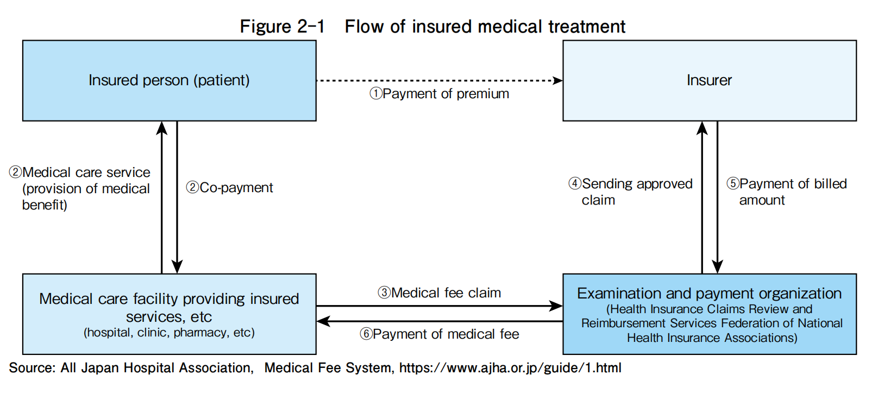
Medical Insurance System (in Japan)
The universal health insurance system provides medical care to all citizens.

Slide 16
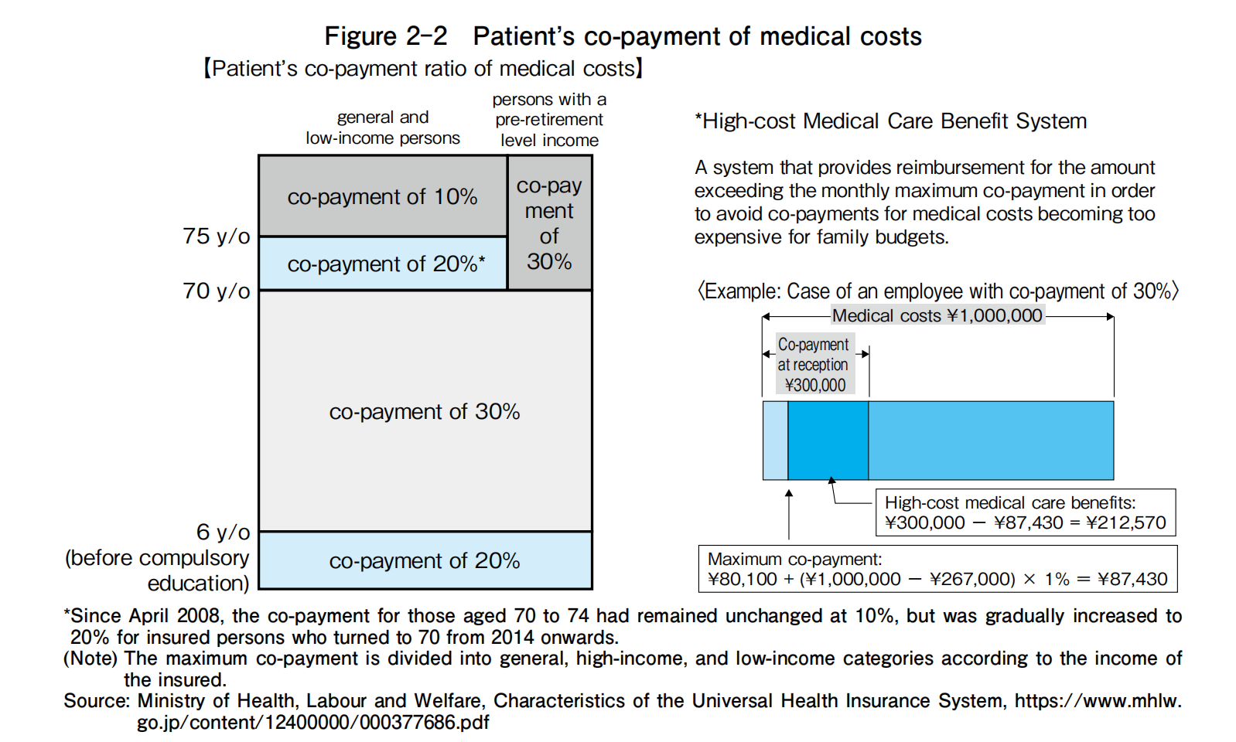
Medical Insurance System (in Japan)

Slide 17
Medical Insurance System (in Japan)
Payment mechanism for medical costs
The payment of medical costs is based on a fee-for-service system, where a fixed number of points are assigned to each medical procedure, including examinations, tests, treatments, hospitalizations, surgeries, and medications.
As of 2022, the unit price for one point is set at 10 yen. The total number of points for the medical procedures provided is multiplied by 10 yen to calculate the medical costs, and the patient pays a certain percentage of this amount as a co-payment. Under the current fee-for-service system, medical practitioners are incentivized to perform more medical procedures because their compensation increases with each procedure. Therefore, there is less incentive to control costs. As a result, a comprehensive payment system has been adopted for some hospitalizations and outpatient services to address this issue.

Slide 18
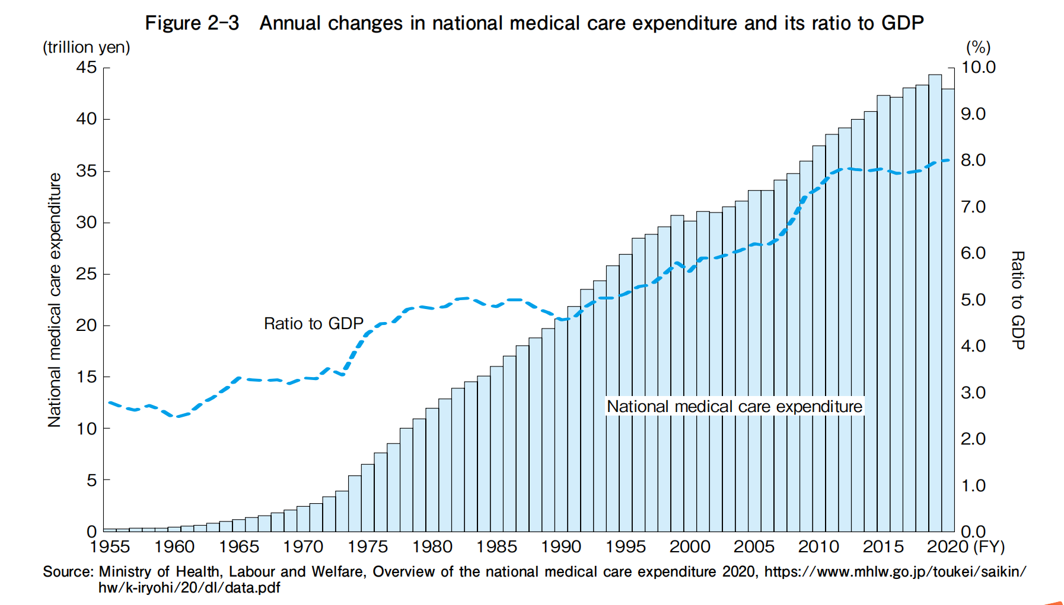
Medical Insurance System (in Japan)
Trends in medical care expenditure

Slide 19
Medical Insurance System (in China)
Basic medical insurance includes two systems:
employee medical insurance (covers the urban employed population)
resident medical insurance (covers the urban non-employed population and the rural population)
The urban employed are required to enroll in an employment-based program, which is funded primarily via employer and employee payroll taxes. Other residents can voluntarily enroll in Urban-Rural Resident Basic Medical Insurance, financed primarily by central and local governments through individual premium subsidies.
By the end of 2023, about 1.334 billion people had participated in basic medical insurance, with coverage stable at more than 95%.

Slide 20
Medical Insurance System (in China)
Publicly financed basic medical insurance typically covers:
inpatient hospital care (selected provinces and cities)
primary and specialist care
prescription drugs
mental health care
physical therapy
emergency care
traditional Chinese medicine
But,
Most dental services (such as cleaning), durable medical equipment (such as wheelchairs and hearing aids), home care and hospice care are paid out-of-pocket.
Deductibles, copayments, and reimbursement ceilings apply. There is no annual cap on out-of-pocket spending. Complementary private health insurance helps cover cost-sharing and coverage gaps.
Notes:
But,
A few dental services (such as tooth extraction, but not cleaning) and optometry services are covered, but most are paid out-of-pocket. Home care and hospice care are often not included either. Durable medical equipment, such as wheelchairs and hearing aids, is often not covered.
Preventive services, such as immunization and disease screening, are included in a separate public-health benefit package funded by the central and local governments; every resident is entitled to these without copayments or deductibles. Coverage is person-specific; there are no family or household benefit arrangements.
Maternity care is also covered by a separate insurance program; it is currently being merged into the basic medical insurance plan.

Slide 21
Medical Insurance System (in China)
Reimbursement terms:
The insured persons must go to the designated medical institutions of basic medical insurance for medical treatment and purchase drugs, or take the medical prescription issued by the doctor of the designated hospital to the designated retail pharmacies determined by the social insurance institution to purchase drugs.
The medical expenses incurred by the insured during the process of seeing a doctor must conform to the scope and payment standard of the drug catalogue, diagnosis and treatment items, and medical service facilities of the basic medical insurance, before they can be paid by the basic medical insurance fund according to regulations.
Notes:
Among the medical expenses covered by the basic medical insurance, the part of the expenses above the starting payment standard and below the maximum payment limit of the social medical pooling fund shall be paid by the social medical pooling fund in a unified proportion.

Slide 22
Medical Insurance System (in China)
Reimbursement ratio:
Due to the different operation methods of local systems, payment limits and out-of-pocket ratios are also different. In addition, for medical treatment in other areas, in principle, full out-of-pocket payment (can also be partially reimbursed).
Residents in rural areas who travel across cities to seek higher levels of care must be prepared to pay out-of-pocket. The higher the level, the higher the proportion of self-payment.
Registration, appointment of doctors, preparation of medical records, etc., need to be paid in advance. In addition, a deposit must be paid for examinations and hospitalization.
Public services have ambulances (120) but charge a fee.
Depending on the level of the doctor, the cost of the initial consultation is different. There is a limit to the amount of medical expenses paid by public insurance, and out-of-pocket expenses tend to be higher for patients with serious illnesses such as cancer or heart disease who want to receive a higher level of medical treatment.

Slide 23
Long-term Care Delivery System (in Japan)
There are currently four types of long-term care insurance facilities available for long-term
care insurance services:
welfare facilities for the elderly requiring long-term care,
health care facilities for the elderly requiring long-term care,
integrated facilities for medical and long-term care,
sanatorium-type medical care facilities for the elderly requiring long-term care.
Facility standards for each type are regulated by law according to their different functions.

Slide 24
Long-term Care Delivery System (in Japan)
Long-term care service establishments are broadly categorized into five categories:
preventive long-term care service establishments,
community-based preventive long-term care service establishments,
in-home service establishments,
community-based service establishments,
in-home long-term care support establishments.

Slide 25
Long-term Care Delivery System (in Japan)
Situation of long-term care workers:
Various health care professionals work alongside care staff and certified care workers in providing long-term care services.
The largest number of nurses is engaged in visiting nursing stations (92,139), followed by day-care service for long-term care (38,225), health care facilities for the elderly requiring long-term care (29,732), and welfare facilities for the elderly requiring long-term care (27,418) in 2021.
Sourse: Ministry of Health, Labour and Welfare: “Ministry of Health, Labour and Welfare, Overview of the 2021 Survey of
Long-Term Care Service Facilities and Establishments,” https://www.mhlw.go.jp/toukei/saikin/hw/kaigo/service21/
dl/gaikyo.pdf

Slide 26
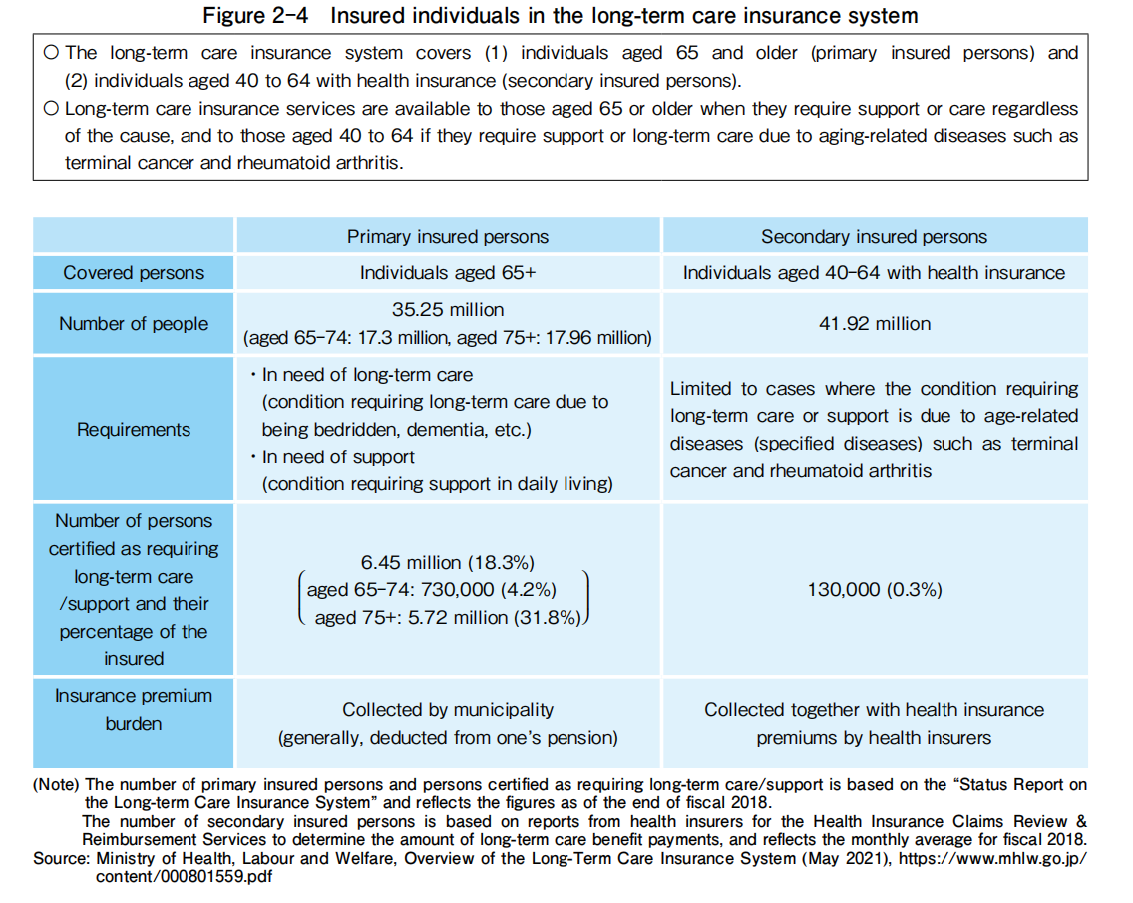
Long-term Care Insurance System (in Japan)

Slide 27
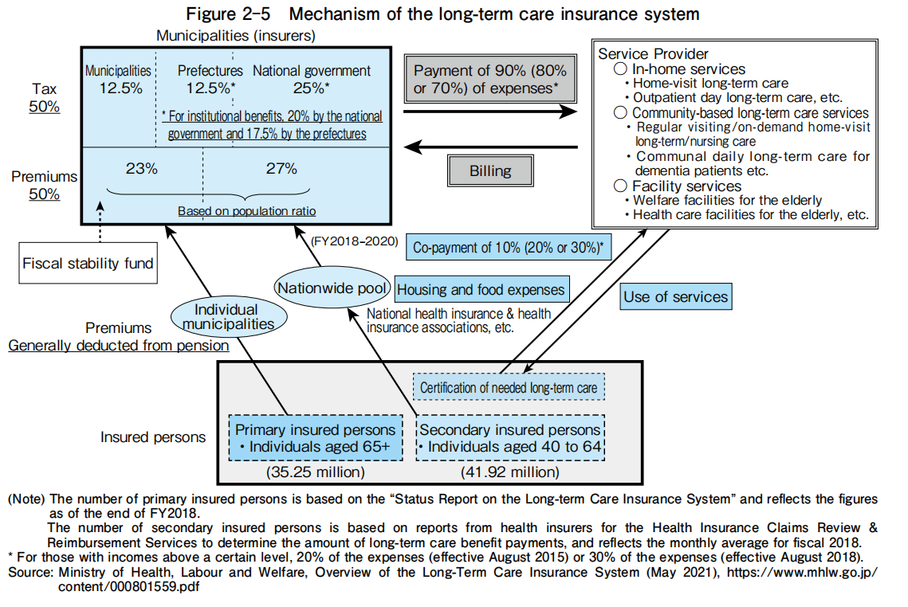
Long-term Care Insurance System (in Japan)
The payment of long-term care costs is calculated by adding regional and labor supplements based on the location of the service provider to the basic remuneration set for each service.
The monthly upper limit for using long-term care services is determined according to the level of care needed, based on the certification of needed long-term care.
While users mainly choose the services they want to use, for in-home long-term care services such as visiting nursing, care managers intervene and create a care plan that combines services according to individual needs. Users pay a certain percentage (as described above) as co-payment, but they are responsible for paying the full amount exceeding the upper limit.

Slide 28
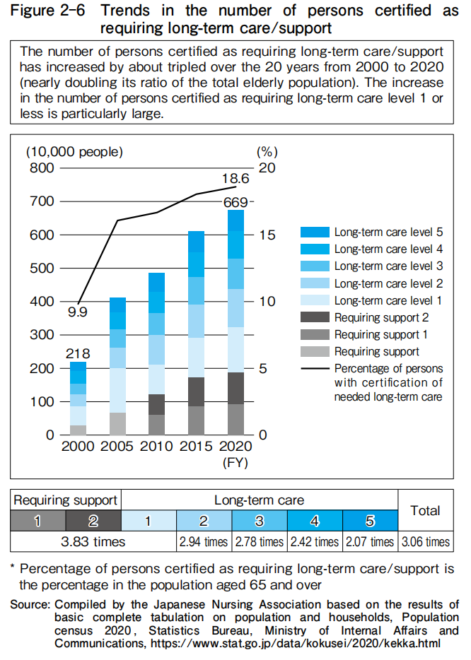
Long-term Care Insurance System (in Japan)
Trends in long-term care expenditure:
As society rapidly ages, the number of people with the certification of needed long-term care has been increasing every year, resulting in an increase in the total expenditure of long-term care insurance.

Slide 29
Long-term Care Insurance System (in China)
In order to actively respond to the aging population, in June 2016, the Ministry of Human Resources and Social Security issued the Guiding Opinions on carrying out the Pilot Long-term Care Insurance System (Department of Human Resources and Social Security issued [2016] No. 80), which for the first time piloted the long-term care insurance system in 15 cities across the country.
In September 2020, the State Medical Insurance Administration and the Ministry of Finance jointly issued the "Guiding Opinions on Expanding the Pilot Long-term Care Insurance System" (Medicare [2020] 37), and decided to pilot long-term care insurance in 14 new cities across the country.
As of March 2022, there are 49 prefecture-level cities (states) in the country, including provincial-level pilot long-term care insurance.
For nursing service expenses that meet the regulations, the fund's payment level is generally controlled at about 70%, long term insurance beneficiaries must pay 30% of the compliance fee.

Slide 30
Summary
As Japan, China faces a great demand for nursing care and nursing professionals due to its rapidly aging population.
There are perfect medical insurance system for all citizens and long-term care insurance system in Japan.
At present, in China, basic insurance system is still not perfect, regional differences are large, can not solve the problem of residents for anytime, anywhere medical treatment.
In China, long-term care insurance is still in the stage of exploration and trial operation, and has not yet been fully covered.

Slide 31
Suggestion for Health Care Delivery System Perfect and Nursing Education Reform in China
In response to China's aging problem, It is necessary to expand the content of public insurance coverage, eliminate geographical differences and improve reimbursement ratio.
Expanding enrollment scale, refining enrollment specialty (geriatric nursing, community nursing, adult nursing, etc.), strengthening discipline construction, and strengthening professional skills should be the reform direaction for nursing education at present.

