Slide 1
Cultural Competency and Safety: Beyond race and ethnicity
Ika Alifa Suryabrata
Graduate School of Medicine (M1)
Department of International Cooperation for Medical Education

Slide 2
Self-Introduction
Name: Ika Alifa Suryabrata (26)
Origin: Indonesia (Depok, Jogja), currently in Odaiba
Background: Medical Doctor (UIN Jakarta)
Academic staff at the Faculty of Medicine
Previous research: assessment (OSCE), reflective and feedback practice
Research interest: assessment, learning process, and learning environment
よろしくおねがいしす

Slide 3
Outline
Cultural Competence overview
Cultural safety overview
Cultural competence and safety interactions
Implementation in Education
Challenges in implementing cultural competence and safety
Key Takeways

Slide 4
Culture
The integrated pattern of human behaviour that includes thoughts, communications, actions, customs, beliefs, values, and institutions of a racial, ethnic, religious, or social. (Cross,1989)

Slide 5
01
Cultural Competence
Cultural competence is a set of congruent behaviours, attitudes, and policies that come together in a system, agency, or among professionals and enable that system, agency, or those professionals to work effectively in cross-cultural situations (Cross,1989)
The ability of systems to provide care to patients with diverse values,
beliefs and behaviours, including tailoring delivery to meet patients’
social, cultural, and linguistic needs (Betancourt,2002)
1. Cross, T., B. Bazron, and M. lsaccs, Towards a Culturally Competent System of Care: A Monograph on Effective Services for Minority Children Who Are
Severely Emotionally Disturbed. CASSP technical assistance Centre. Washington DC: Georgetown University Child Development Center; 1989.
2. Betancourt J, Green A, Carillo J. Cultural Competence in Health Care:Emerging Frameworks and Practical Approaches. 2002. The Commonwealth
Fund: New York.

Slide 6
01
Cultural Competence Model
Cultural Destructiveness
Cultural incapacity
Cultural blindness
Cultural Pre-competence
Cultural Proficiency
1. Cross, T., B. Bazron, and M. lsaccs, Towards a Culturally Competent System of Care: A Monograph on Effective Services for Minority Children Who Are
Severely Emotionally Disturbed. CASSP technical assistance Centre. Washington DC: Georgetown University Child Development Center; 1989.

Slide 7
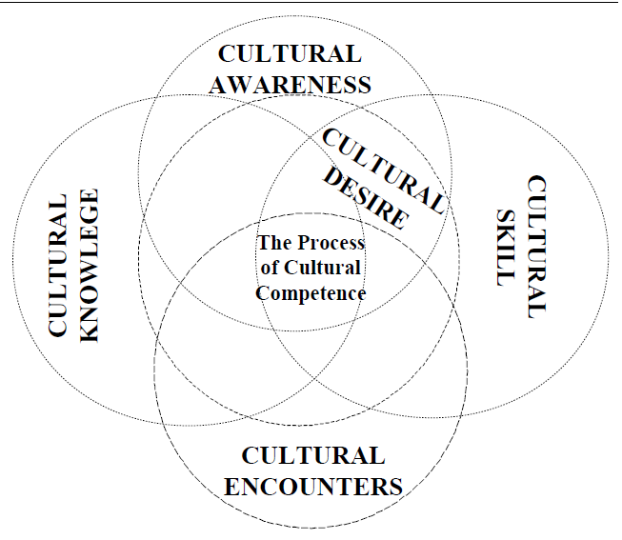
01
Cultural Competence Model
1. Capinha-Bacote, J. The Process of Cultural Competence in the Delivery of Healthcare Services: A Model of Care. Journal od Transcultural Nursing

Slide 8
01
Cultural Competence
Other important terminology
Cultural Security
Cultural adaptation
Cultural humility
Cultural sensitivity
1. Curtis, E., et al. Why Cultural Safety Rather than Cultural Competency is Required to Achieve Health Equity: A Literature Review and Recommended Definition. International Journal for Equity in Health. 2019;18 (174)

Slide 9
01
Cultural Competence
Examples
A rural clinic adapts their chronic disease management program for Indigenous patients using community health workers and culturally relevant diet modifications.
A provider modifies communication approach with a patient who has low health literacy and comes from a collectivist culture, involving family in decision-making.

Slide 10
02 Cultural Safety
Cultural Safety is a mechanism which allows the recipient of care to say whether or not the service is safe for them to approach and use
extends beyond cultural awareness, sensitivity, and skills-based competencies and is predicated on understanding the power differentials inherent in health care service delivery to redress these inequities through educational processes, focusing on reflexive thinking
1. Ramsden, I., Cultural Safety and Nursing Education in Aotearoa and Te Waipounamu. A thesis submitted to the Victoria University of Wellington in fulfilment of the requirements for the degree of Doctor of Philosophy in Nursing, in Department of Nursing. 2002, Victoria University of Wellington Wellington. p. 211.
2. Rowan, M.S., et al., Cultural competence and cultural safety in Canadian Schools of Nursing: A mixed methods study. Int J Nurs Educ Scholarsh, 2013. 10(1).

Slide 11
02 Cultural Safety
Patient-defined safety
The patient determines if the environment is culturally safe
Self-reflection
Providers must interrogate their own cultural identities and biases
System-level relevance
Power dynamics
Recognizing the power differential between provider and patient
Goes beyond individual care to healthcare systems, policy, and education

Slide 12
02 Cultural Safety
A provider modifies communication approach with a patient who has low health literacy and comes from a collectivist culture, involving family in decision-making
Achieve cultural safety: as the patient wants the family to be involved, communication approach was appropriate, the provider asking for feedback after the decision-making
Not achieved: the patient doesn’t want the family to be involved, communication modification feels degraded patient’s knowledge, there is no reflection or feedback in the process

Slide 13
03 Cultural competence and Safety Interactions
 | No Reflection (Low Safety) | Reflective Practice (High Safety)
Low Competence | Risk of harm, accidental insensitivity | Growth zone: patient feels heard, trust is built
High Competence | Rigid, stereotyped, unsafe | Ideal: safety + skill + humility

Slide 14
04 Challenges in Cultural Safety and Competence
Various terminology
Focused on cultural competence
Lack of policies
Lack of training
Lavoie, JG., et al. Cultural competence and safety in Circumpolar countries: an analysis of discourses in healthcare. International Journal of Circumpolar Health. 2022;81.
Shepherd, et al. The challenge of cultural competence in the workplace: perspectives of healthcare providers. BMC Health Services Research. 2019;19 (135)
Abubakari, A., Gross, J., Asamoah, E., Barries to Delivery of Culturally Competent care Among Nurses: A Multi-center Cross-Sectional Study in a Resource-Limited Setting. International Journal of Africa Nursing Science. 2024; 20

Slide 15
05 Implementation in Education
Curricula for developing cultural competence had been applied
Development of understanding about other’s culture
Communication skill training
To develop/promote awareness of culture-based care; it is aimed that at the end of this course, students would be capable of evaluating individuals, families, and communities in a proper and evidence-based manner, and they would be competent to plan, implement and evaluate culture-based nursing care.
Further directions
Incorporating or identification of informal and hidden curricula to also be addressed
Tosun, B., et al. Evaluating the effectiveness of a new curriculum for transcultural nursing education: a mixed-method study. 2024; 24:813. BMC Nursing
Paul, D., Ewen, SC., Jones, R. Cultural competence in medical education: aligning the formal, informal and hidden curricula. Adv in Health Sci Educ. 2014;19

Slide 16
06
Key Takeaways
Cultural competence and safety are interchangeable and plays as a dynamic process
Shifting the paradigm to the receiver of the practice (both patients and healthcare professionals) is necessary
Individual, agencies, and systems play a role in achieving both cultural competency and safety
Implementing both in healthcare setting and education is equally important to ensure lifelong learning

Slide 17
Reference
Cross, T., B. Bazron, and M. lsaccs, Towards a Culturally Competent System of Care: A Monograph on Effective Services for Minority Children Who Are Severely Emotionally Disturbed. CASSP technical assistance Centre. Washington DC: Georgetown University Child Development Center; 1989.
Betancourt J, Green A, Carillo J. Cultural Competence in Health Care:Emerging Frameworks and Practical Approaches. 2002. The Commonwealth Fund: New York.
Capinha-Bacote, J. The Process of Cultural Competence in the Delivery of Healthcare Services: A Model of Care. Journal od Transcultural Nursing
Curtis, E., et al. Why Cultural Safety Rather than Cultural Competency is Required to Achieve Health Equity: A Literature Review and Recommended Definition. International Journal for Equity in Health. 2019;18 (174)
Ramsden, I., Cultural Safety and Nursing Education in Aotearoa and Te Waipounamu. A thesis submitted to the Victoria University of Wellington in fulfilment of the requirements for the degree of Doctor of Philosophy in Nursing, in Department of Nursing. 2002, Victoria University of Wellington Wellington. p. 211.
Rowan, M.S., et al., Cultural competence and cultural safety in Canadian Schools of Nursing: A mixed methods study. Int J Nurs Educ Scholarsh, 2013. 10(1)
Lavoie, JG., et al. Cultural competence and safety in Circumpolar countries: an analysis of discourses in healthcare. International Journal of Circumpolar Health. 2022;81.
Shepherd, et al. The challenge of cultural competence in the workplace: perspectives of healthcare providers. BMC Health Services Research. 2019;19 (135)
Abubakari, A., Gross, J., Asamoah, E., Barries to Delivery of Culturally Competent care Among Nurses: A Multi-center Cross-Sectional Study in a Resource-Limited Setting. International Journal of Africa Nursing Science. 2024; 20
Tosun, B., et al. Evaluating the effectiveness of a new curriculum for transcultural nursing education: a mixed-method study. 2024; 24:813. BMC Nursing
Paul, D., Ewen, SC., Jones, R. Cultural competence in medical education: aligning the formal, informal and hidden curricula. Adv in Health Sci Educ. 2014;19

